Slide 1


Slide 2


Slide 3


Slide 4

We work…

Slide 5
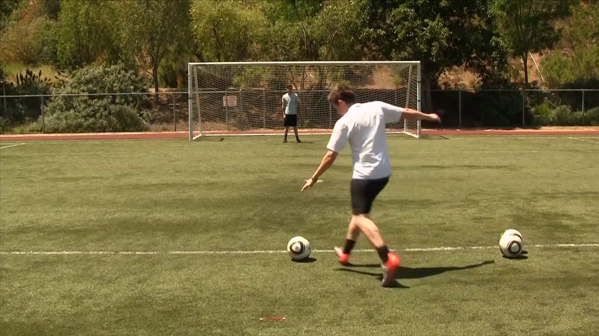
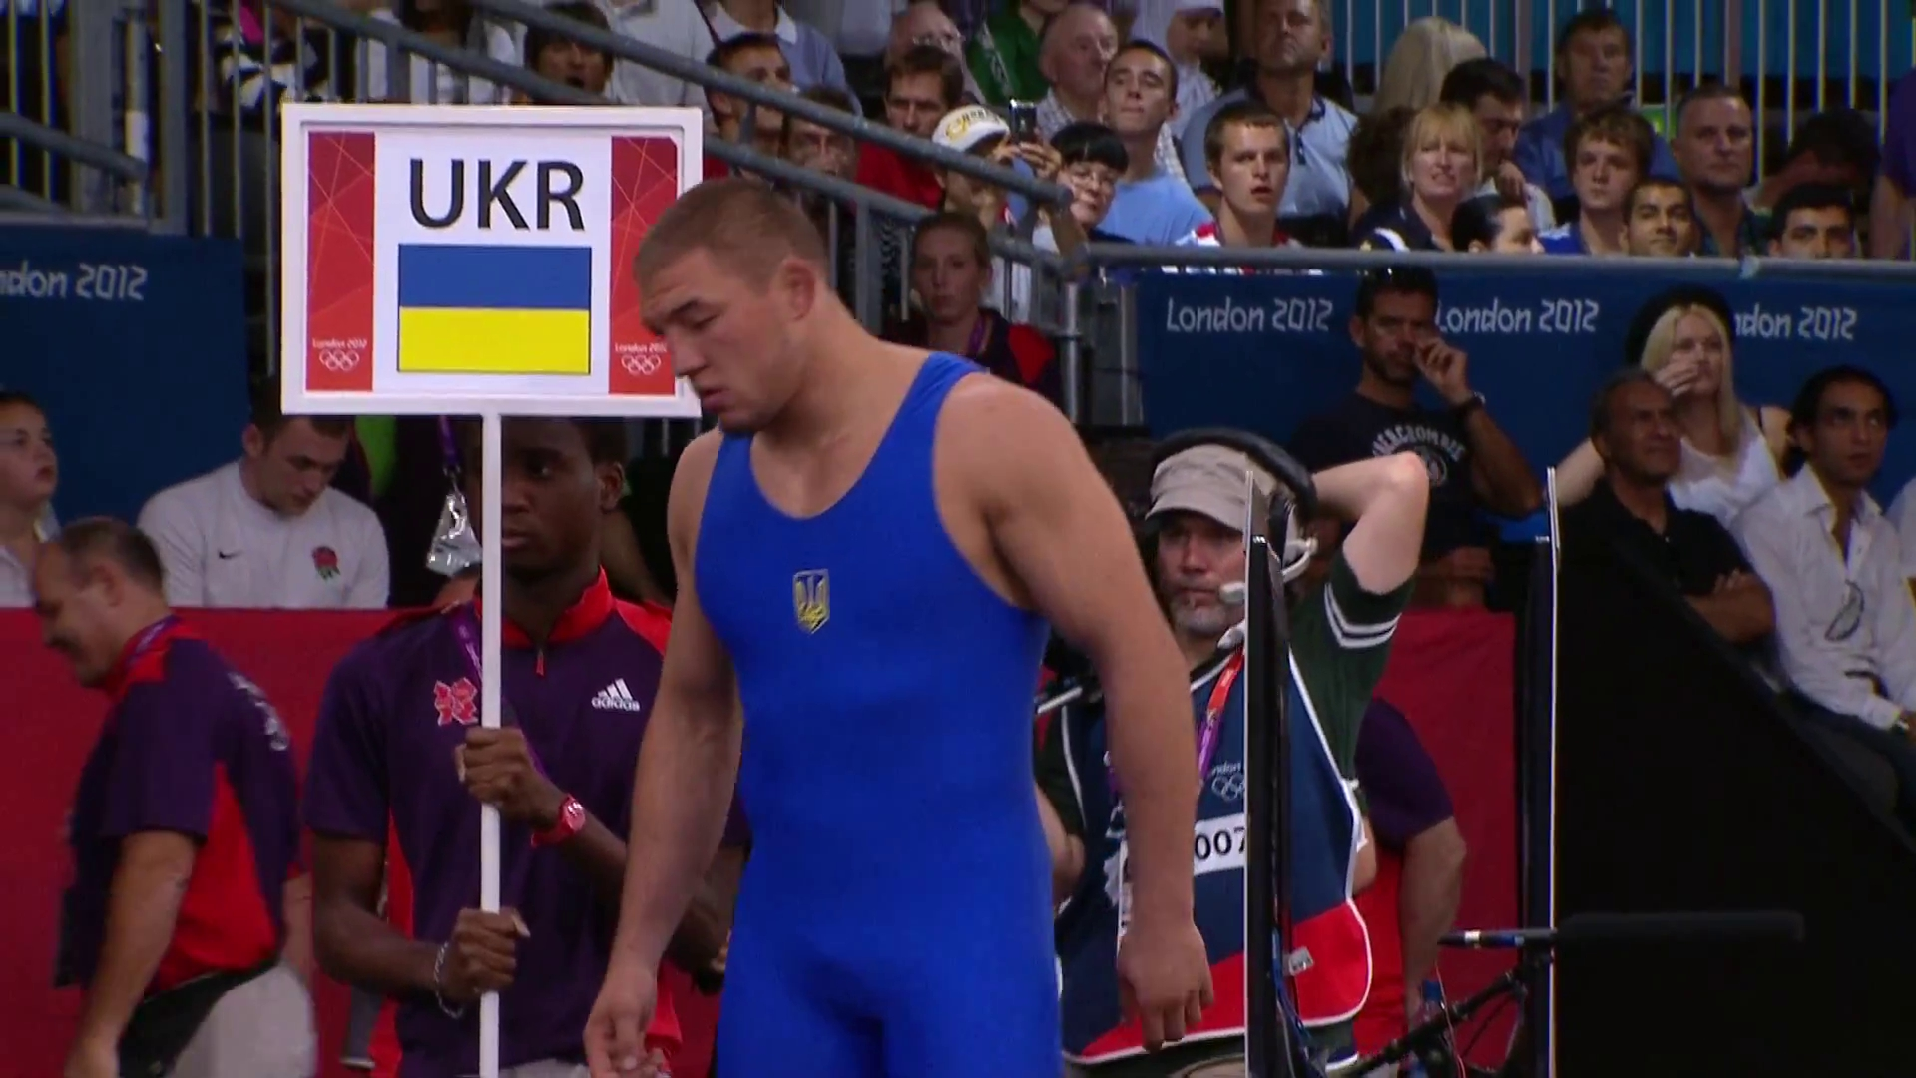

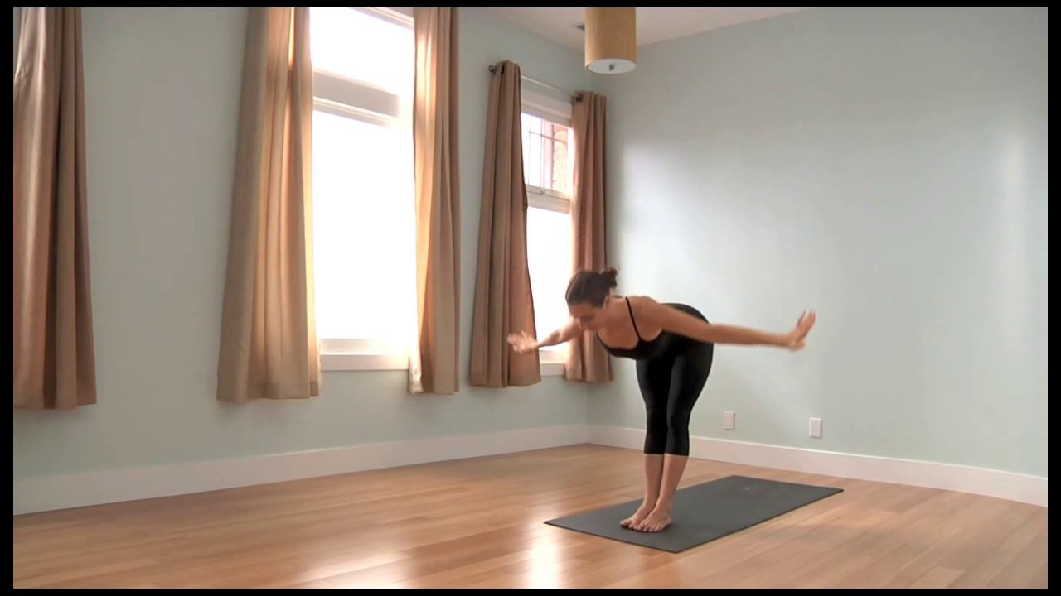

Slide 6
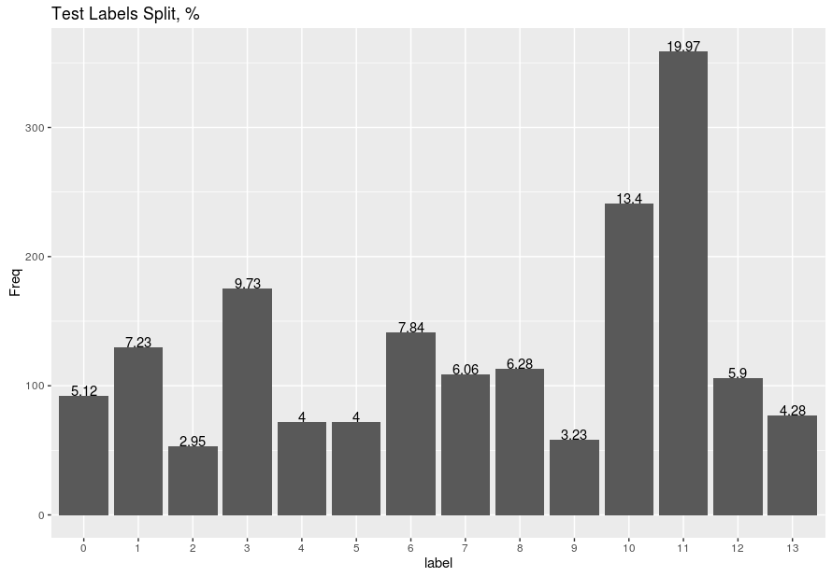

Slide 7
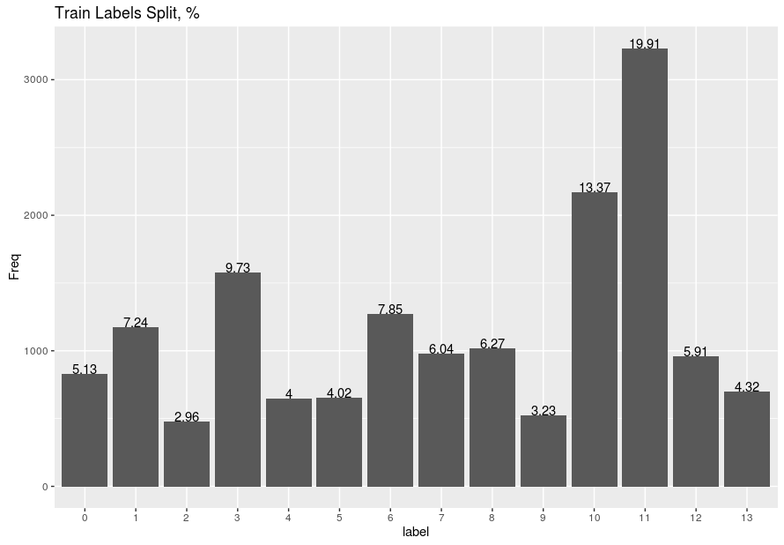

Slide 8


Slide 9
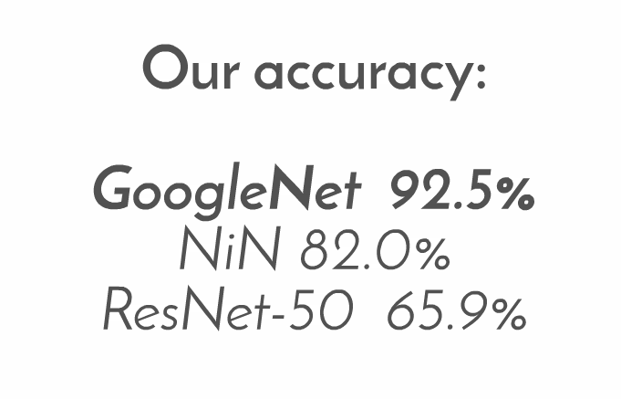
95%

Slide 10
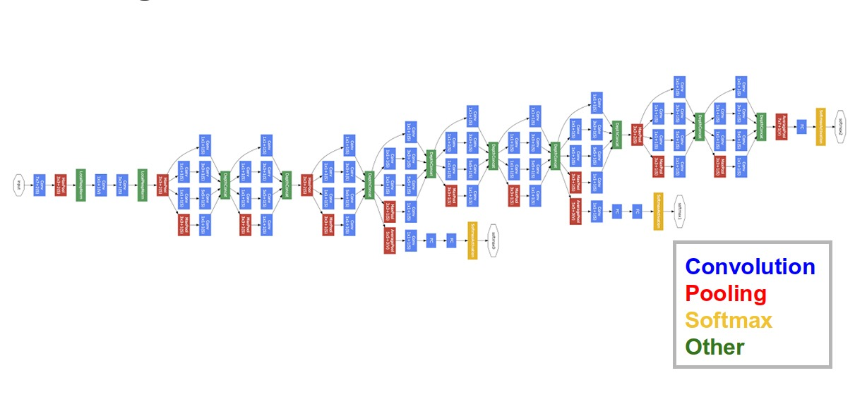
GoogleNet

Slide 11
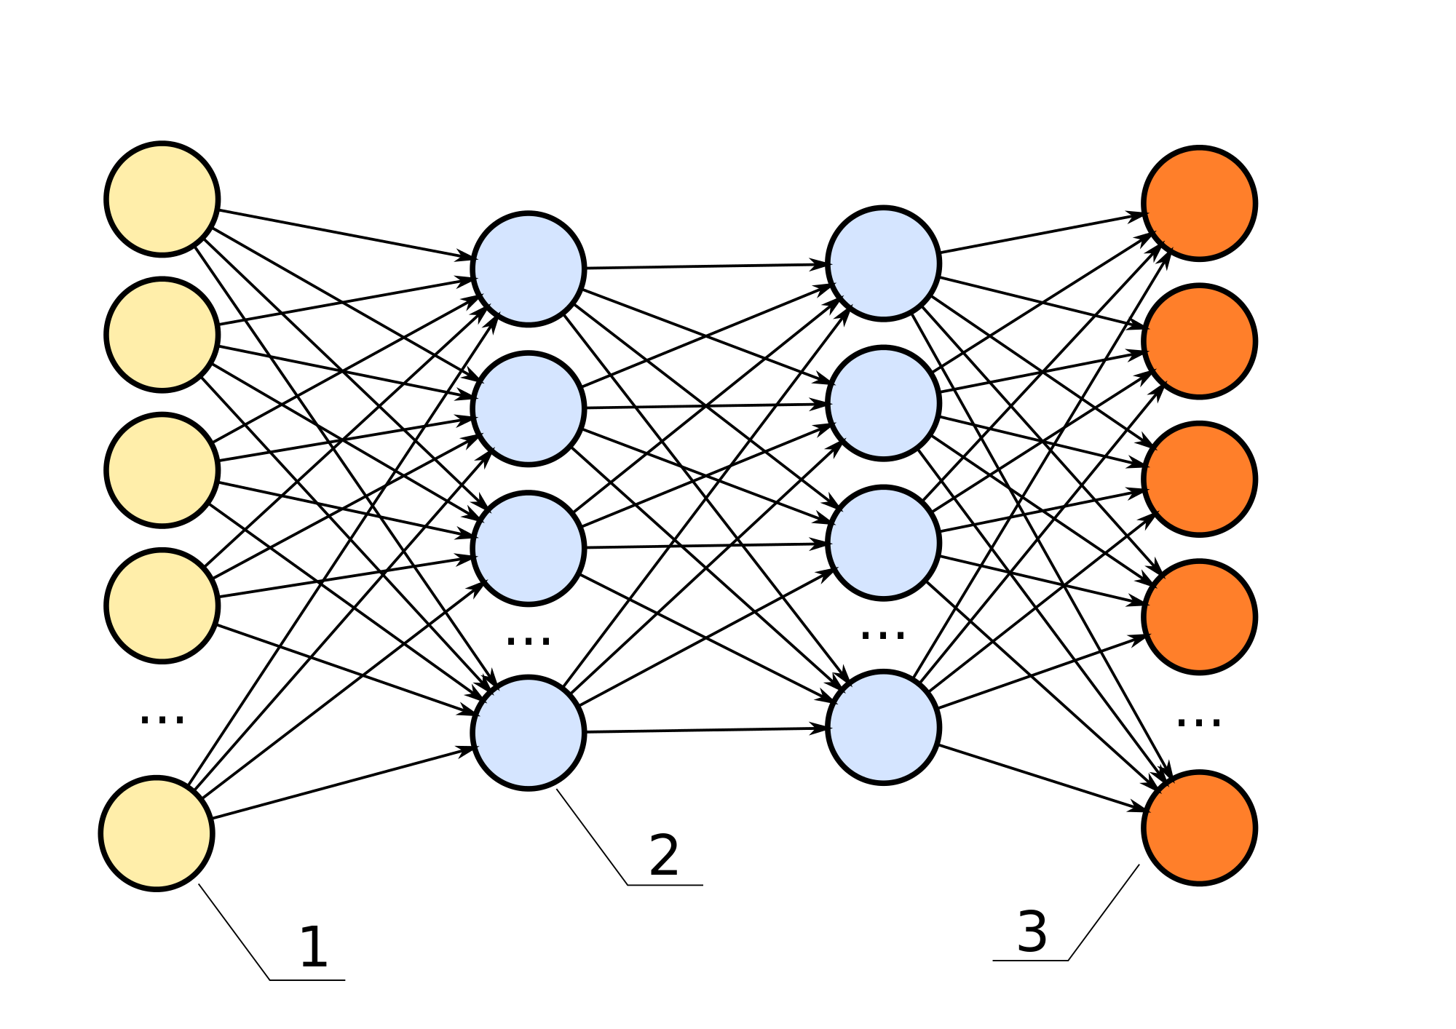

Slide 13

Parameter updates
ADAM
ADAGRAD
RMSProp
Nesterov accelerated gradient
ADADELTA

Slide 14


Parameter updates
http://cs231n.github.io/neural-networks-3/

Slide 15
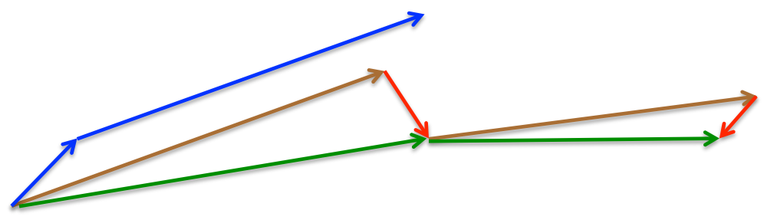
Nesterov Momentum
θ = θ - η▼θJ(θ; x(i:i+n); y(i:i+n))
vt = γvt-1 + η▼θJ(θ – γvt-1)
θ = θ – vt

Slide 16
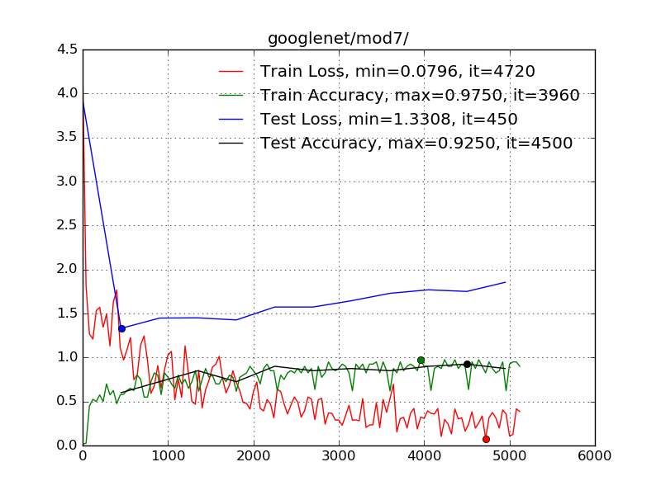
Example of overfitting using Nesterov Momentum

Slide 17
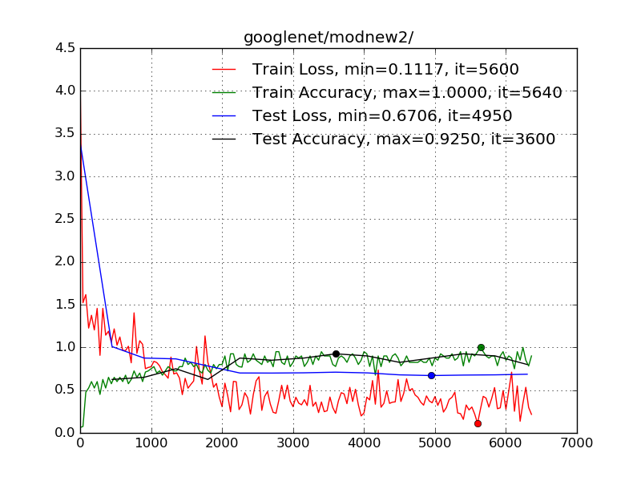
Example of best model with Nesterov Momentum
base_lr: 0.001
lr_policy: "step"
stepsize: 2000
gamma: 0.1

Slide 18
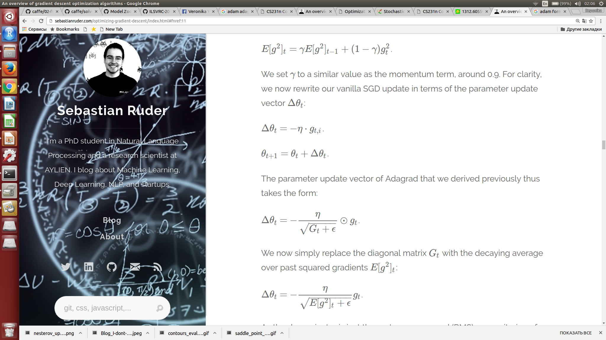
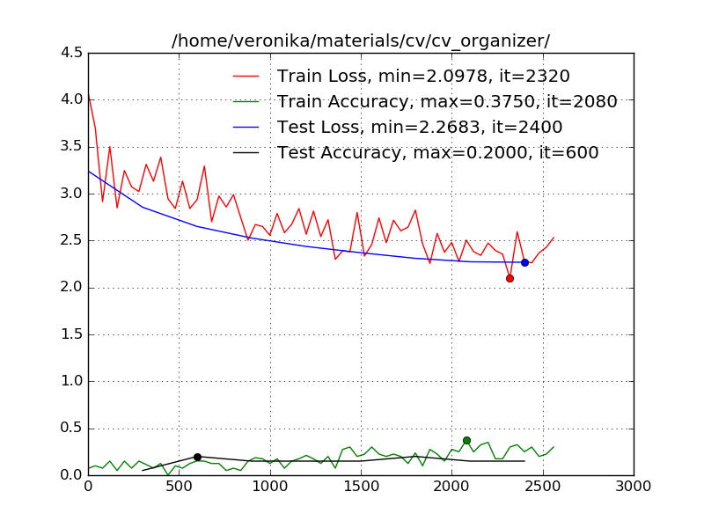
Example of model with RMSProp
E[g2]t = 0.9E[g2]t-1 + 0.1gt2
θt+1 = θt - ηgt*(1/sqrt(E[g2]t + ε))
base_lr: 0.001
lr_policy: "step"
stepsize: 2000
gamma: 0.1

Slide 19
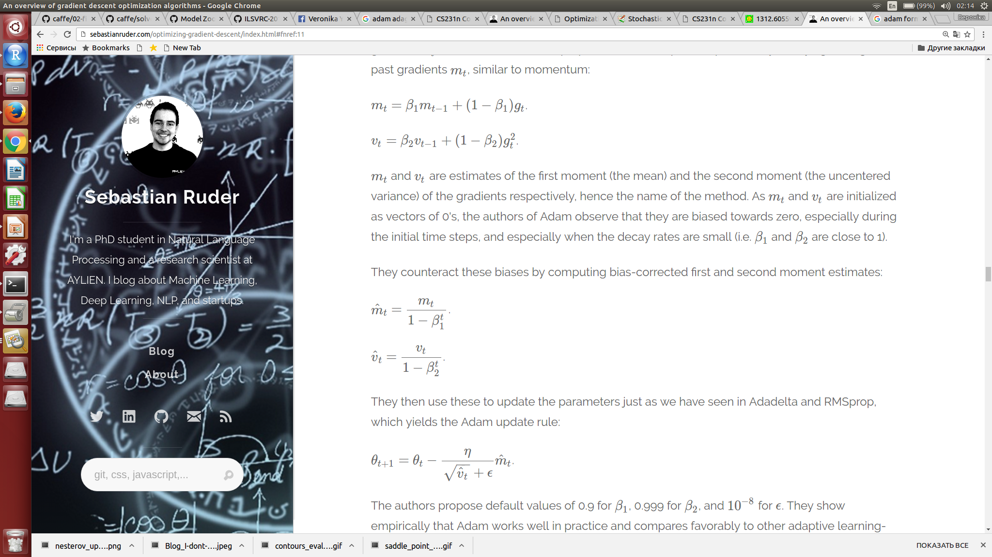


Example of model with Adam
mt = β1mt-1 + (1 - β1)gt
vt = β2vt-1+ (1 - β2)gt2
mt = mt/(1 – β1t)
vt = vt /(1 - β2t)
θt+1= θt - ηmt/(sqrt(vt ) + ε)

Slide 20
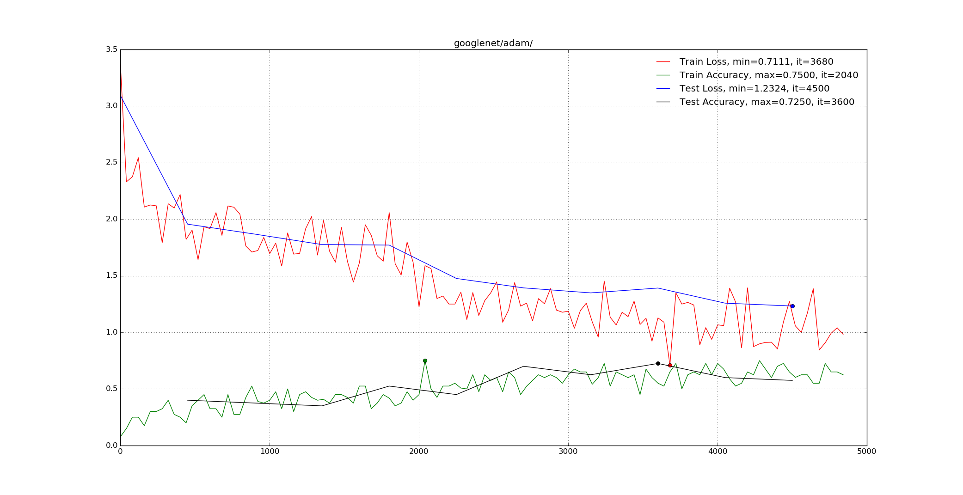
Example of model with Adam
base_lr: 0.001
lr_policy: "step"
stepsize: 2000
gamma: 0.1

Slide 21
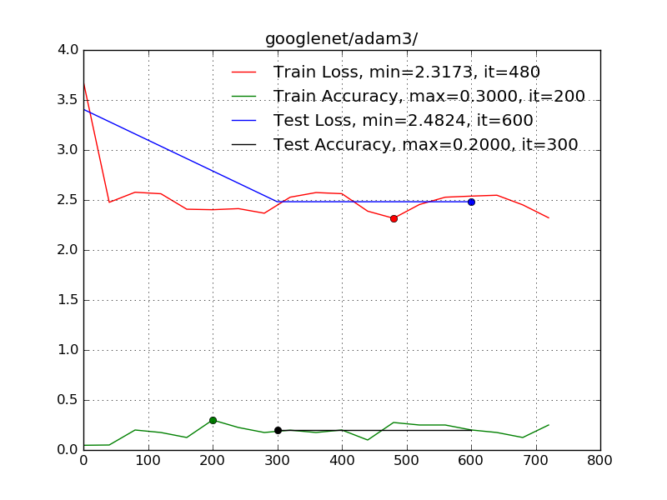
Example of model with Adam
base_lr: 0.001
lr_policy: "step"
stepsize: 2000
gamma: 0.1

Slide 22
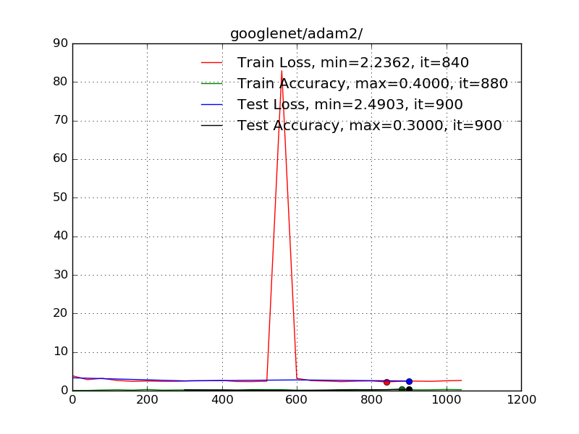
Example of model with Adam
base_lr: 0.01
lr_policy: "step"
stepsize: 2000
gamma: 0.1

Slide 23
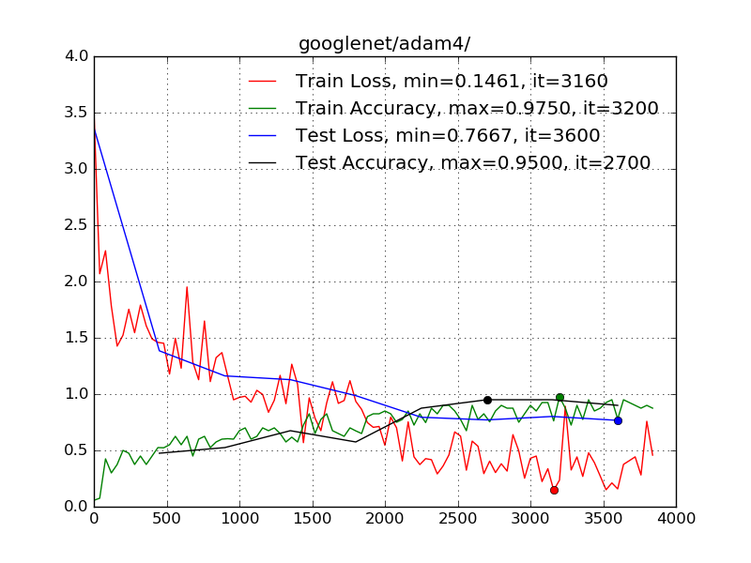
Example of best model with Adam
base_lr: 0.0005
lr_policy: "step"
stepsize: 2000
gamma: 0.1

Slide 24


Slide 25
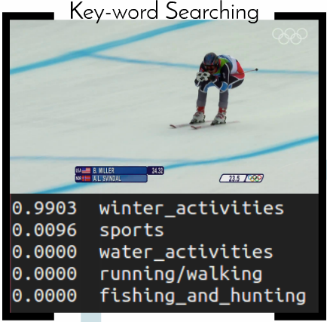
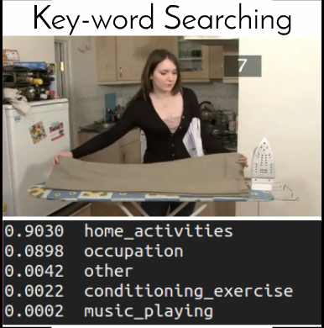
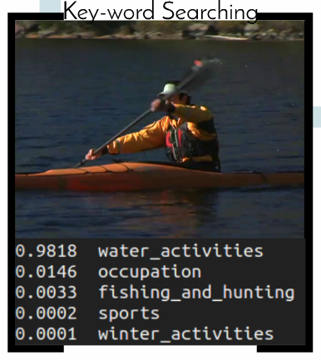
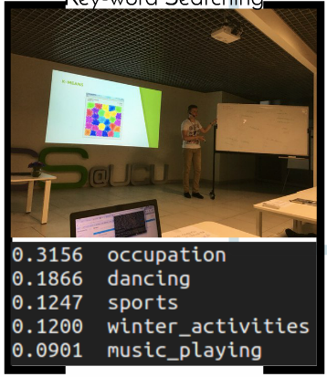

Slide 26
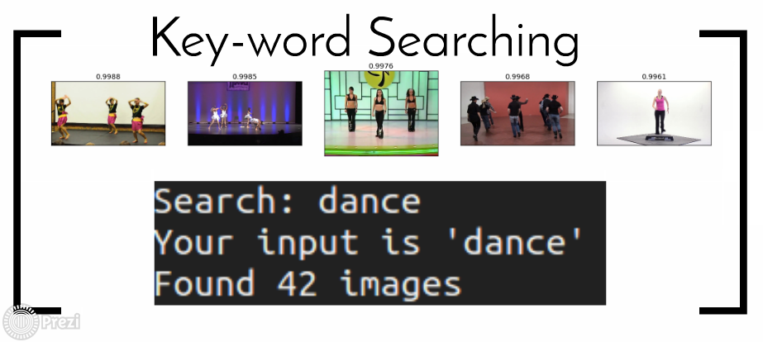


Slide 27
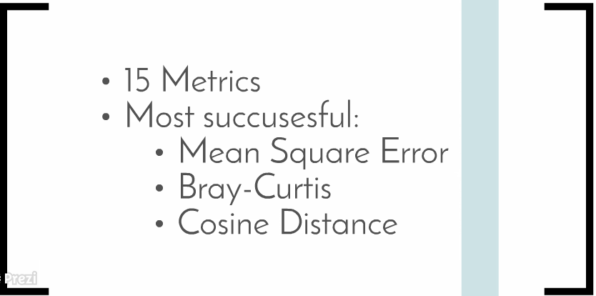

Slide 28


Slide 29
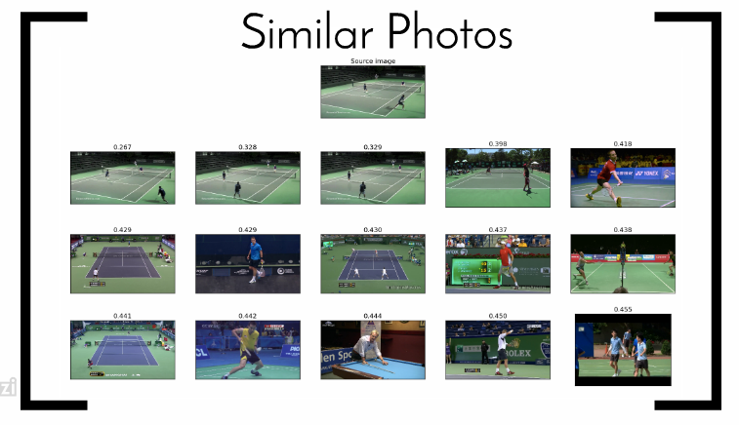

Slide 30
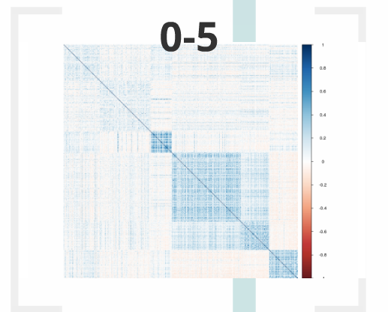
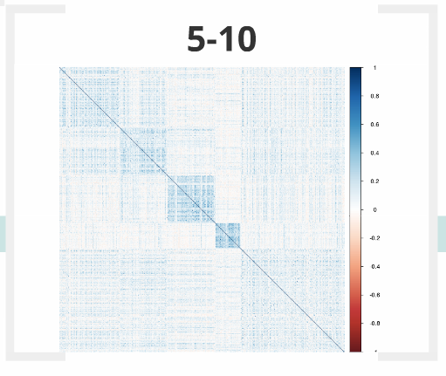
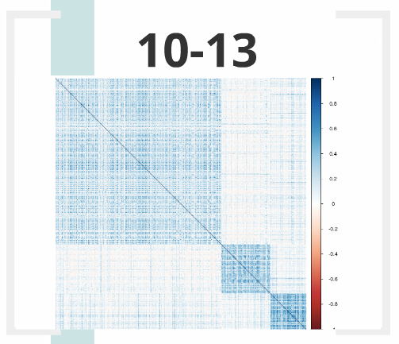

Slide 31
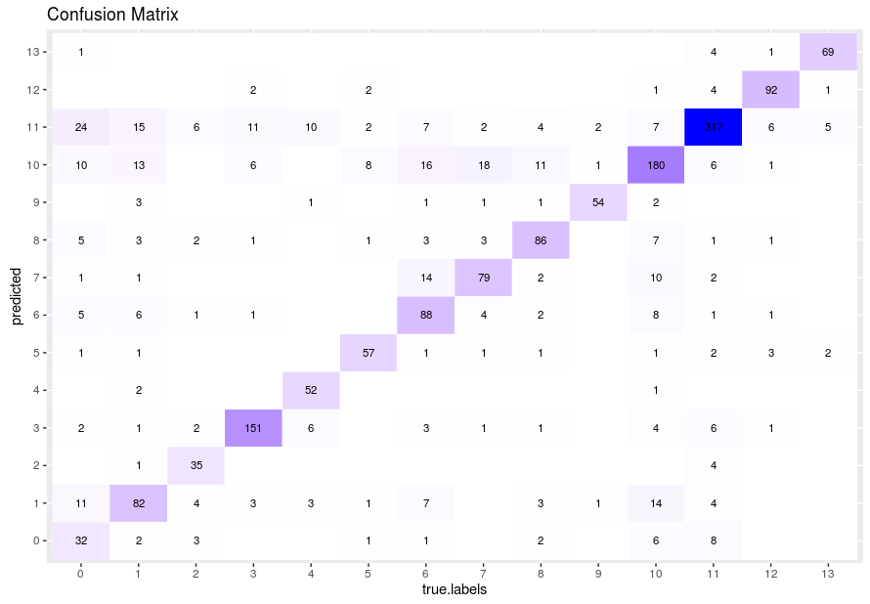

Slide 32



Slide 33


